Slide 1
The Relational Data Model

Slide 2
Relational Model Concepts
  The relational model represents the database as a collection of relations. Informally, each relation resembles a table of values or, to some extent, a "flat" file of records.
  When a relation is thought of as a table of values, each row in the table represents a collection of related data values.

Slide 3
Relational Model Concepts
  In the formal relational model terminology, a row is called a tuple, a column header is called an attribute, and the table is called a relation. The data type describing the types of values that can appear in each column is called a domain.

Slide 4
Domains, Attributes, Tuples, and Relations
  A domain D is a set of atomic values. By atomic we mean that each value in the domain is indivisible as far as the relational model is concerned.
  A common method of specifying a domain is to specify a data type from which the data values forming the domain are drawn.

Slide 5
Domains, Attributes, Tuples, and Relations
Some examples of domains:
    USA_phone_numbers: The set of 10-digit phone numbers valid in the United States.
    Local_phone_numbers: The set of 7-digit phone numbers valid within a particular area code in the United States.
    Social_security_numbers: The set of valid 9-digit social security numbers.
    Names: The set of names of persons.

Slide 6
Domains, Attributes, Tuples, and Relations
Some examples of domains (continued):
    Grade_point_averages: Possible values of computed grade point averages; each must be a real (floating point) number between 0 and 4.
    Employee_ages: Possible ages of employees of a company; each must be a value between 15 and 80 years old.
    Academic_department_names: The set of academic department names, such as Computer Science, Economics, and Physics, in a university.
    Academic_department_codes: The set of academic department codes, such as CS, ECON, and PHYS, in a university.

Slide 7
Domains, Attributes, Tuples, and Relations
  The preceding examples are called logical definitions of domains. A data type or format is also specified for each domain.
    For example, the data type for the domain USA_phone_numbers can be declared as a character string of the form (ddd)ddd-dddd, where each d is a numeric (decimal) digit and the first three digits form a valid telephone area code.
    The data type for Employee_ages is an integer number between 15 and 80.
    For Academic_department_names, the data type is the set of all character strings that represent valid department names.

Slide 8
Domains, Attributes, Tuples, and Relations
A domain is thus given a name, data type, and format.
  Additional information for interpreting the values of a domain can also be given; for example, a numeric domain such as Person_weights should have the units of measurement—pounds or kilograms.

Slide 9
Domains, Attributes, Tuples, and Relations
  A relation schema R, denoted by R(A₁, A₂, . . ., A_{n}), is made up of a relation name R and a list of attributes A₁, A₂, . . ., A_{n}. Each attribute A_{i} is the name of a role played by some domain D in the relation schema R. D is called the domain of A_{i} and is denoted by dom(A_{i}). A relation schema is used to describe a relation; R is called the name of this relation. The degree of a relation is the number of attributes n of its relation schema.

Slide 10
Domains, Attributes, Tuples, and Relations
An example of a relation schema for a relation of degree 7, which describes university students, is the following:
  STUDENT(Name, SSN, HomePhone, Address, OfficePhone, Age, GPA)
  For this relation schema, STUDENT is the name of the relation, which has seven attributes. We can specify the following previously defined domains for some of the attributes of the STUDENT relation: dom(Name) = Names; dom(SSN) = Social_security_numbers; dom(HomePhone) = Local_phone_numbers, dom(OfficePhone) = Local_phone_numbers, and dom(GPA) = Grade_point_averages.

Slide 11
Domains, Attributes, Tuples, and Relations
  A relation (or relation state) r of the relation schema R(A₁, A₂, . . ., A_{n}), also denoted by r(R), is a set of n-tuples r = {t₁, t₂, . . ., t_{m}}. Each n-tuple t is an ordered list of n values t = <v₁, v₂, . . ., v_{n}>, where each value v_{i}, 1 1 i 1 n, is an element of dom(A_{i}) or is a special null value.
  The i^{th} value in tuple t, which corresponds to the attribute A_{i}, is referred to as t[A_{i}]. The terms relation intension for the schema R and relation extension for a relation state r(R) are also commonly used.

Slide 12
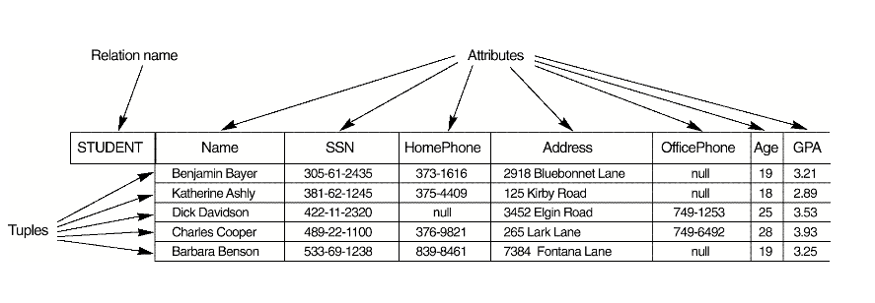
Domains, Attributes, Tuples, and Relations
Example

Slide 13
Domains, Attributes, Tuples, and Relations
  Out of all the possible combinations, a relation state at a given time—the current relation state—reflects only the valid tuples that represent a particular state of the real world.
  In general, as the state of the real world changes, so does the relation, by being transformed into another relation state.
  However, the schema R is relatively static and does not change except very infrequently—for example, as a result of adding an attribute to represent new information that was not originally stored in the relation.

Slide 14
Domains, Attributes, Tuples, and Relations
  It is possible for several attributes to have the same domain. The attributes indicate different roles, or interpretations, for the domain. For example, in the STUDENT relation, the same domain Local_phone_numbers plays the role of HomePhone, referring to the "home phone of a student," and the role of OfficePhone, referring to the "office phone of the student."

Slide 15
Characteristics of Relations
  The earlier definition of relations implies certain characteristics that make a relation different from a file or a table.
  These characteristics are . . . .

Slide 16
Ordering of Tuples in a Relation
A relation is defined as a set of tuples.
  Mathematically, elements of a set have no order among them; hence tuples in a relation do not have any particular order.
  However, in a file, records are physically stored on disk so there always is an order among the records. This ordering indicates first, second, i^{th}, and last records in the file. Similarly, when we display a relation as a table, the rows are displayed in a certain order.

Slide 17
Ordering of Tuples in a Relation
  Tuple ordering is not part of a relation definition, because a relation attempts to represent facts at a logical or abstract level.

Slide 18
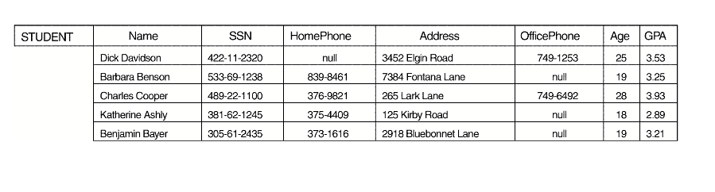
Ordering of Tuples in a Relation
No logical difference:

Slide 19
Ordering of Tuples in a Relation
  According to the preceding definition of a relation, an n-tuple is an ordered list of n values, so the ordering of values in a tuple—and hence of attributes in a relation schema definition—is important. However, at a logical level, the order of attributes and their values are not really important as long as the correspondence between attributes and values is maintained.

Slide 20
Ordering of Tuples in a Relation
  An alternative definition of a relation can be given, making the ordering of values in a tuple unnecessary. In this definition, a relation schema R = {A₁, A₂, . . ., A_{n}} is a set of attributes, and a relation r(R) is a finite set of mappings r = {t₁, t₂, . . ., t_{m}}, where each tuple t_{i} is a mapping from R to D, and D is the union of the attribute domains; that is, D = dom(A₁) D dom(A₂) D. . .D dom(A_{n}). In this definition, t[A_{i}] must be in dom(A_{i}) for 1 1 i 1 n for each mapping t in r. Each mapping t_{i} is called a tuple.

Slide 21
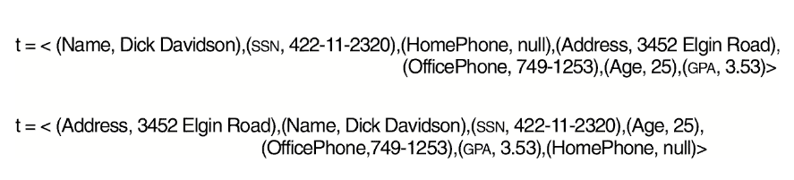
Ordering of Tuples in a Relation
Thus, there is no logical difference between the following:

Slide 22
Values in the Tuples
  Each value in a tuple is an atomic value; that is, it is not divisible into components within the framework of the basic relational model.
    Thus, composite and multivalued attributes are not allowed. Much of the theory behind the relational model was developed with this assumption in mind, which is called the first normal form assumption.
    Multivalued attributes must be represented by separate relations, and composite attributes are represented only by their simple component attributes.

Slide 23
Interpretation of a Relation
  The relation schema can be interpreted as a declaration or a type of assertion.
    For example, the schema of the STUDENT relation asserts that, in general, a student entity has a Name, SSN, HomePhone, Address, OfficePhone, Age, and GPA.
  Each tuple in the relation can then be interpreted as a fact or a particular instance of the assertion.
    For example, the first tuple asserts the fact that there is a STUDENT whose name is Benjamin Bayer, SSN is 305-61-2435, Age is 19, and so on.

Slide 24
Interpretation of a Relation
  Notice that some relations may represent facts about entities, whereas other relations may represent facts about relationships.
    For example, a relation schema MAJORS (StudentSSN, DepartmentCode) asserts that students major in academic departments; a tuple in this relation relates a student to his or her major department.
  Thus, the relational model represents facts about both entities and relationships uniformly as relations.

Slide 25
Relational Model Notation
The text uses the following notation:
    A relation schema R of degree n is denoted by R(A₁, A₂, . . ., A_{n}).
    An n-tuple t in a relation r(R) is denoted by t = <v₁, v₂, . . ., v_{n}>, where v_{i} is the value corresponding to attribute A_{i}. The following notation refers to component values of tuples:
    Both t[A_{i}] and t.A_{i} refer to the value v_{i} in t for attribute A_{i}.
    Both t[A_{u}, A_{w}, . . ., A_{z}] and t.(A_{u}, A_{w}, . . ., A_{z}), where A_{u}, A_{w}, . . ., A_{z} is a list of attributes from R, refer to the subtuple of values <v_{u}, v_{w}, . . ., v_{z}> from t corresponding to the attributes specified in the list.

Slide 26
Relational Model Notation
The text uses the following notation (cont.):
    The letters Q, R, S denote relation names.
    The letters q, r, s denote relation states.
    The letters t, u, v denote tuples.
    In general, the name of a relation schema such as STUDENT also indicates the current set of tuples in that relation—the current relation state—whereas STUDENT(Name, SSN, . . .) refers only to the relation schema.
    An attribute A can be qualified with the relation name R to which it belongs by using the dot notation R.A—for example, STUDENT.Name or STUDENT.Age. This is because the same name may be used for two attributes in different relations. However, all attribute names in a particular relation must be distinct.

Slide 27
Relational Model Notation
  As an example, consider the tuple t = <‘Barbara Benson’, ‘533-69-1238’, ‘839-8461’, ‘7384 Fontana Lane’, null, 19, 3.25> from the STUDENT relation; we have t[Name] = <‘Barbara Benson’>, and t[SSN, GPA, Age] = <‘533-69-1238’, 3.25, 19>.

Slide 28
Thank You

